Slide 1


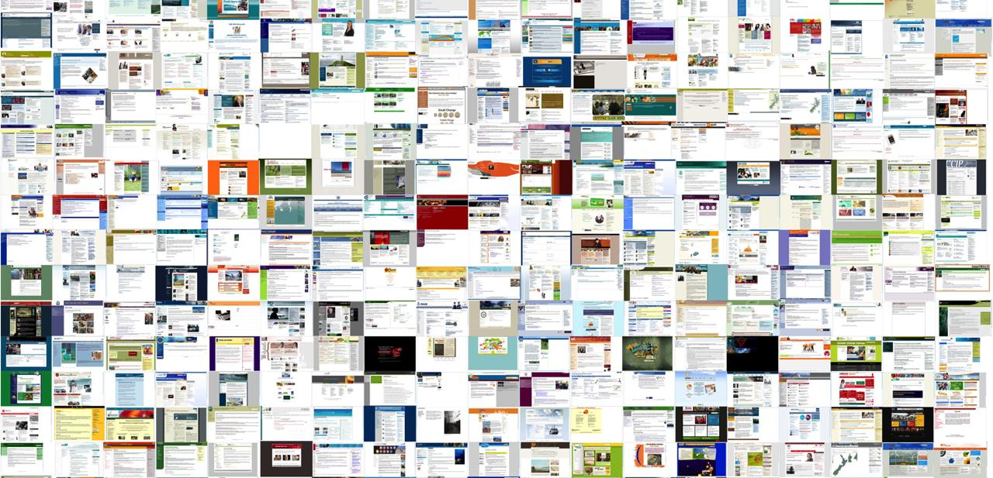
YOU GET VISITORS TO YOUR WEBSITE
NOW MAKE THEM COUNT
Notes:
Good morning and welcome everybody.
I thank you for taking the time to listen to my presentation and I hope you leave this webinar with a better understanding of where the world is going and how the Corona pandemic has thrust us into this new world a lot faster than we would have expected.
I would argue that after the covid-19 lockdown, people are going to be a lot more capable in online shopping and their desire to reduce face-to-face interactions with potential carriers of the virus will be a lot higher.
That brings me to today's topic is "providing online support and chat”.

Slide 2


REAL-TIME CONVENIENCE TO CUSTOMERS
INCREASE CONVERSIONS AND SALES
LIVE CHAT AGENTS AND TOOLS
Notes:
So I'll start with the benefits of adding a live chat or a smart chatbot to your website and also cover a few of the obstacles. – For the purposes of my presentation I will distinguish between a chatbot (pre programmed conversations with no human interactions) and live chat (live Humans speaking directly to visitors)
The first and most important feature of a live chat solution is that it should generate sales and increase lead conversions.
Secondly, it should reduce inbound customer support calls to your teams by offering a superb support function.
You want your Live Chat to answer 100% of your common support questions and have a procedure in place to assist with any questions they cannot handle.
When you have this in place, you need to train customers to visit your online site first

Slide 3
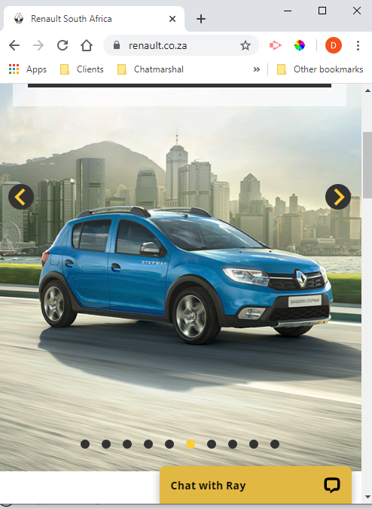
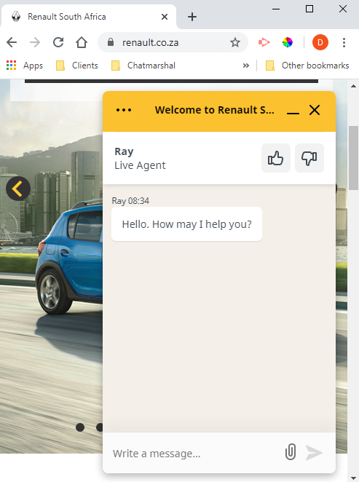
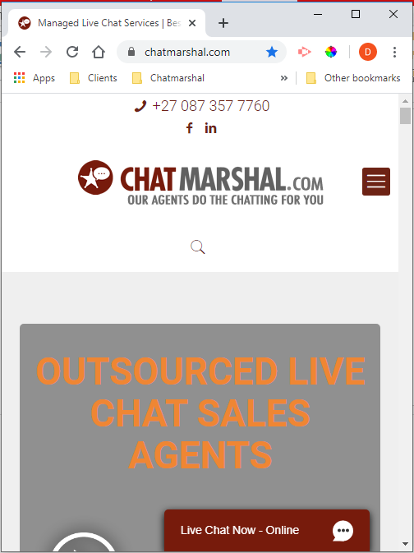
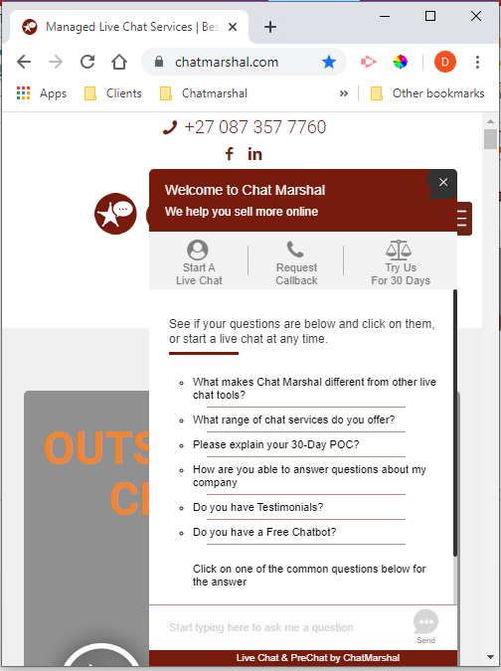
52% OF GLOBAL WEB PAGES WERE SERVED TO MOBILE PHONES IN 2018
Notes:
In this slide I have tried to highlight what a website and live chat looks like on a mobile device
You can clearly see that with the live chat visitors can simple ask any question they want without navigating
Also, that statistic is from 2019 looking back at 2018 – imagine what it is now in 2020 and going forward

Slide 4


DESIGN YOUR LIVE CHAT SERVICE AND WHO WILL BE ONLINE TO CHAT – TRAIN THEM?
LIVE CHAT AGENTS AND TOOLS
Notes:
But let’s focus first on Live Chat for Sales.
If you are going to add live chat to your website you first have to decide who will be chatting on your behalf as well as what time of day they will be online – is it office hours or 24 hours a day? Also what training will you need to give the agents?
This is important because whoever you have online needs to be there. You can do brand damage if you have live chat but it is slow or unattended.
It’s quite simple really. When a visitor comes to your site and is able to talk to you and get immediate answers they are more likely to do business with you.

Slide 5
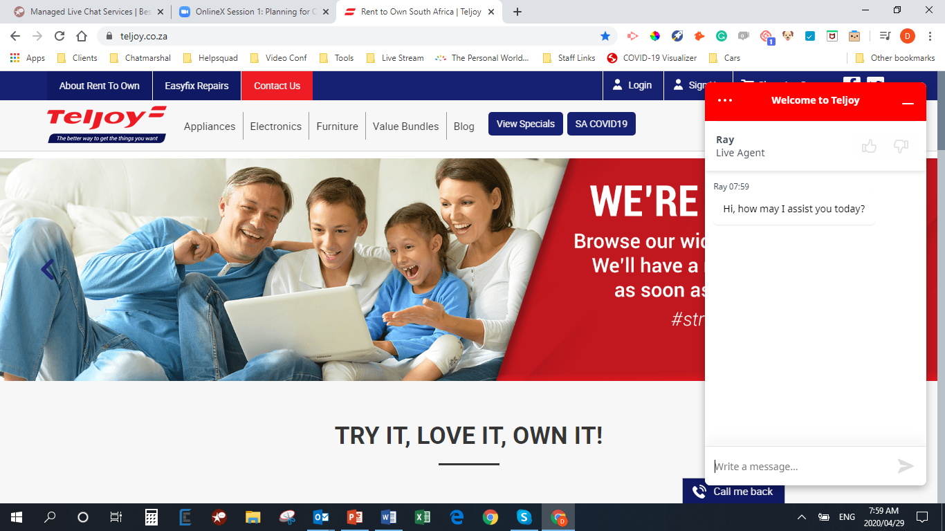
Notes:
Here is a company that successfully uses live chat – Teljoy south Africa
The live chat is used for new potential clients who want to rent a TV and the Live chat agents will assist visitors and even offer other products that compliment the TV
Added to that, the agent assists people with the application process and answers all technical questions about the applications, delivery dates, cancelations and so on.
This is a perfect example of live chat for sales and support.

Slide 6
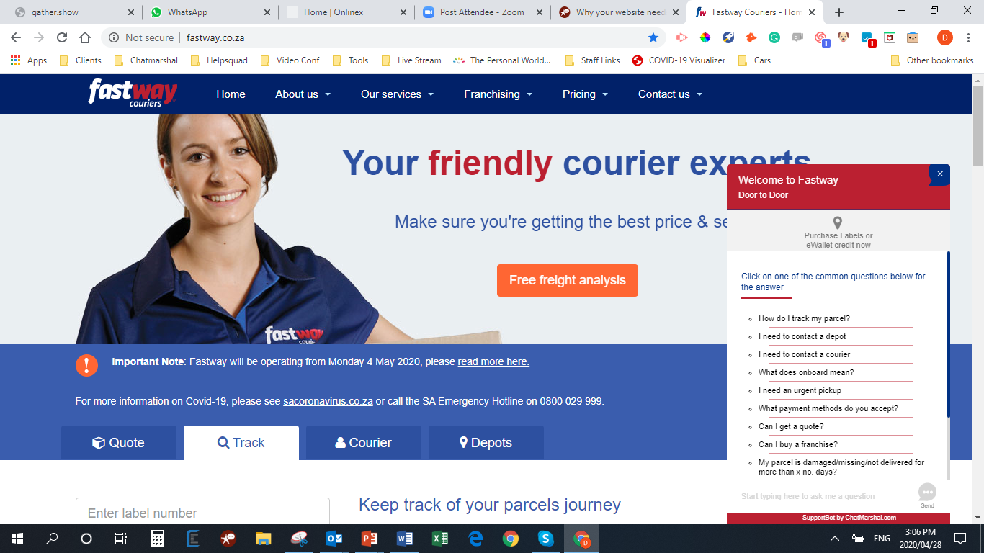
Notes:
Now let’s focus on support. – Here is fastway couriers using a chatbot solution for support.
One of the biggest problems we have with the live chat or chatbots is the annoyance Factor when the interaction doesn't lead the visitor to their desired outcome or at least the perceived desired outcome that they were expecting.
Support can be as simple as helping visitors with delivery cost information or product questions. It can be used to help customers with returns or order confirmations. None of those require deep knowledge or access to backend IT systems – they can all be handled by trained agents.
Here’s the great news – if you don’t have a team of agents available you can outsource the entire thing. That’s the great thing about chat. A small business can use it just as effectively as a large business with a massive contact centre

Slide 7
REPORTING
See what you visitors are saying with transcripts
Understand time of day volumes
Manage support tickets and never let anything slip through
Conduct post chat surveys
LIVE CHAT AGENTS AND TOOLS

Slide 8


LIVE CHAT ALLOWS YOU TO REACT TO POTENTIAL CUSTOMERS FASTER THAN YOUR COMPETITORS
LIVE CHAT AGENTS AND TOOLS
Notes:
We sampled 1000 South African retailers, online shops and consumer-facing websites to find only 1,8% had live chat.
We then sampled 100 random USA online shops and 20% had live chat
So, what does that say about the state of customer service in South Africa? Companies that talk about the customer coming first are not living up to this.
This is a great opportunity for online shops with live chat to get ahead of their competitors

Slide 9
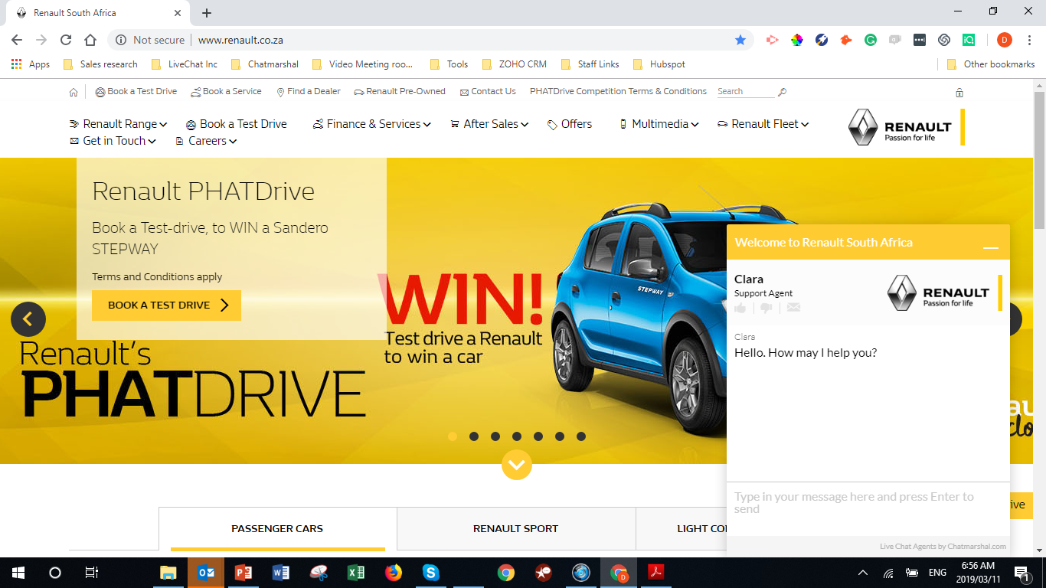
“Since using Live Chat we have increased our direct engagement with clients by over 400% online. Our sales leads through this source have doubled over the period, with no material drop in our closing rate”, Brian Smith, Vice President: Innovation & Projects

Slide 10

https://www.superoffice.com/blog/live-chat-statistics/
25 Reasons Live Chat Can Help you Grow Your Business Posted by Steven MacDonald on 20 April, 2020
Today, more than 41% of customers expect live chat on your website.
  For customers that visit your website on a mobile device, this number is as high as 50%. Therefore, if you don’t offer live chat on your website, then you’re essentially ignoring your customers.
Live chat has become the leading digital contact method for online customers, as a staggering 46% of customers prefer live chat compared to just 29% for email, and 16% for social media.
Kayako reported that 79% of businesses said that implementing live chat resulted in increased customer loyalty, sales and revenue.
Goinflow noted that there was a 3.84% increase in conversion rates, with a 6% overall lift in revenue.
ICMI found that website visitors that engage with your company via live chat are worth 4.5 times more than visitors that don’t.
Forrester noted that there was a 10% increase in the average order value when reviewing the sales from customers who engaged in a chat before making a purchase, than those that did not use chat.

Slide 11
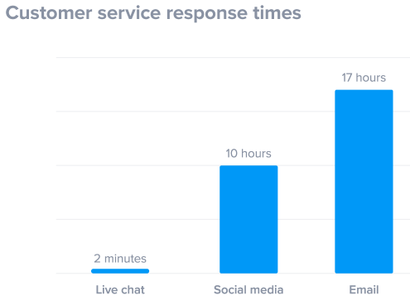
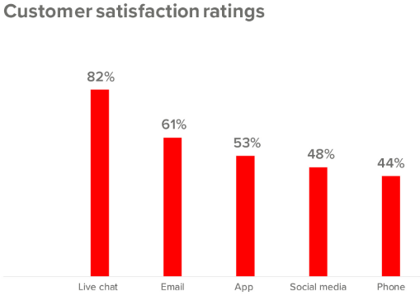
https://www.superoffice.com/blog/live-chat-statistics/
25 Reasons Live Chat Can Help you Grow Your Business Posted by Steven MacDonald on 20 April, 2020

Slide 12
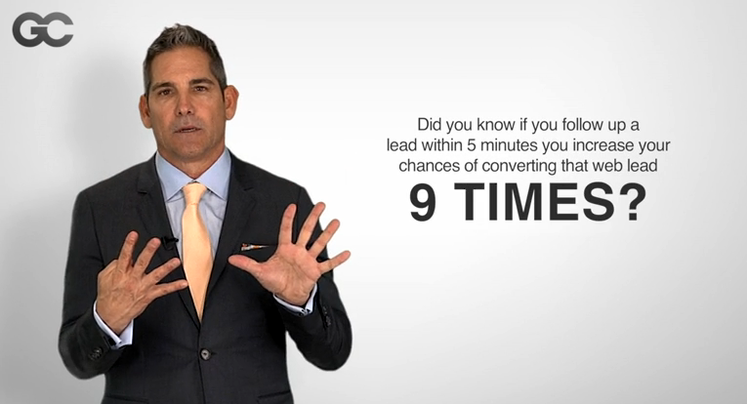
INTERESTING FACT
Grant Cardone
Notes:
There are two kinds of online sales – one where there visitor buys online and one where a visitor wants to speak to a sales person first.
Most businesses don’t have an online sales portal. So here is a sales tip
If you can get a hot lead to a sales person immediately, and they are able to call the prospect while they are still browsing, imagine your sales conversion rates
Training agents to sms or WhatsApp leads to sales people to follow-up will increase sales

